Slide 1
CAP 450
Artificial Intelligence and Intelligent Systems
Sukhbeer Kaur(32918)
Assistant Professor
System And Architecture
Lovely Professional University

Slide 2

Course Outcome
CO1 ::recall key principles of AI, ML, and Python programming, and identify their roles in real-world scenarios through use cases.
CO2 :: understand the techniques involved in data pre- processing, natural language processing, and neural networks, along with the challenges and opportunities they present.
CO3 :: apply the learned techniques to build, optimize, and deploy neural networks, convolutional neural networks, and recommendation systems for practical AI applications.
CO4 :: analyze the effectiveness of AI models through case studies, and design and implement AI solutions for chosen use cases, critically evaluating their impact and results

Slide 3


Text Books and References
TEXT BOOK:
The Hundred-Page Machine Learning Book by Andriy Burkov
REFERENCE BOOKS
Machine Learning by Ethem Alpaydın
Machine Learning by S Sridhar, M Vijayalakshmi.
OTHER READINGS:
Journals articles as Compulsary reading (specific articles, complete reference) - https://www.elementsofai.com/

Slide 4

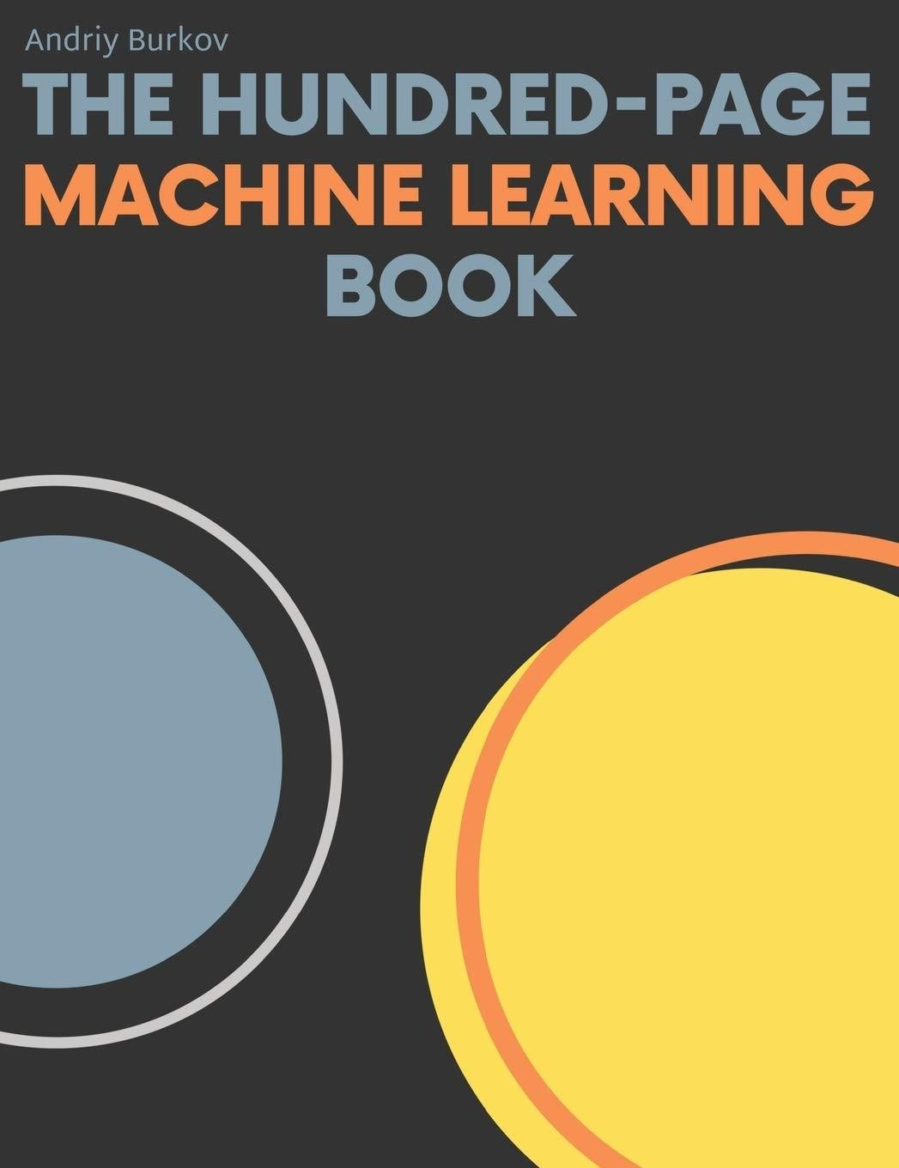
Text Book:
The Hundred-Page Machine Learning Book
Author: Andriy Burkov

Slide 5
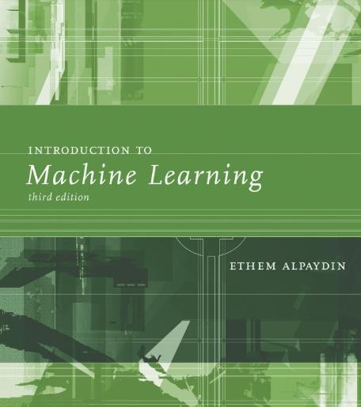
Reference Book: Machine Learning
Author: Ethem Alpaydın
Download:
https://kkpatel7.wordpress.com/wp- content/uploads/2015/04/alppaydin_machinelearning
_2010.pdf

Slide 6
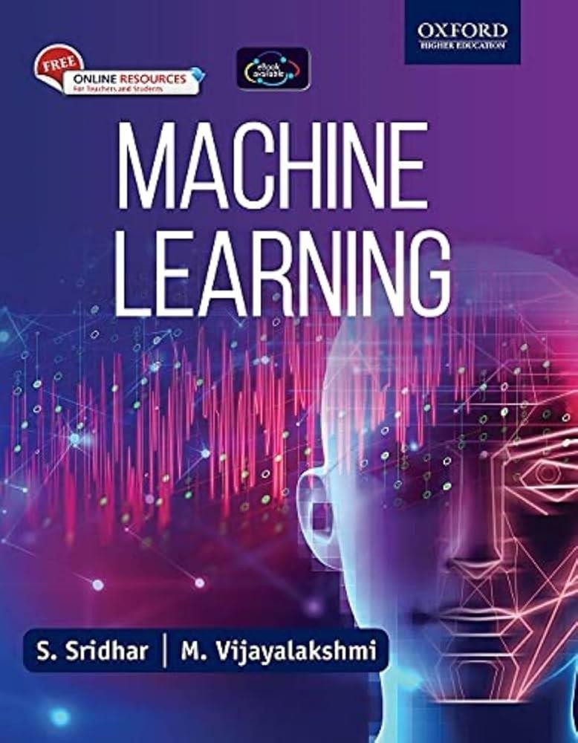
Reference Book: Machine Learning
Author: S Sridhar, M Vijayalakshmi

Slide 7
Relevant Websites
S. No | Web Address | Salient Features
1 | https://www.coursera.org/learn/ai-for-everyone | AI Fundamentals
2 | https://www.edx.org/learn/artificial-intelligence/harvard-university-cs50- s-introduction-to-artificial-intelligence-with- python?index=product&objectID=course-3a31db71-de8f-45f1-ae65- 11981ed9d680&webview=false&campaign=CS50%27s+Introduction+to | AI with Python
3 | https://www.edx.org/learn/computer-programming/edx-advanced- chatgpt?index=product&objectID=course-e463af35-245d-4720-b295- e3bf95beeed7&webview=false&campaign=Prompt+Engineering+and+Adv anced+ChatGPT&source=edX&product_category=course&placement_url= https%3A%2F%2Fwww.edx.org%2Flearn%2Fartificial-intelligence | AI and GPT

Slide 8




Syllabus / Course Outline
UNIT I: Introduction to Artificial Intelligence and Python for Data Analysis
UNIT II: Data
Wrangling Techniques and Natural Language Processing
UNIT III: Introduction to Neural Network and RNN
UNIT IV: Convolution Neural Networks
UNIT V: Build and Deploy AI Application
UNIT VI:
Recommendation
System and Case Study

Slide 9
Introduction to Al and Intelligent Agents,
Search Methods and Knowledge
Representation,
Use Cases of Artificial Intelligence,
Role of Machine Learning Engineer,
Machine Learning Tools & Packages,
Python Data Structures,
Python Programming Fundamentals,
Python Packages,
Working with NUMPY, Pandas, Data
Visualization, Matplotlib and Seaborn
UNIT I

Slide 10
Introduction to Data pre-processing,
Importing the Dataset,
Handling Missing data,
Splitting the data into Train and Test set,
Feature Scaling
Introduction to Natural Language Processing
and NTLK,
Bag of Words model,
Natural Language Processing in Python,
Sentiment analysis using Natural Language
Processing
UNIT II

Slide 11
Neuron and Activation Function,
Neural Networks working and learning,
Gradient Descent,
Stochastic Gradient Descent and Backpropagation
Introduction to Recurrent Neural Networks,
The idea behind Recurrent Neural Networks,
The Vanishing Gradient Problem,
STMs and LSTM Variations Predicting Google
stock prices using RNN,
Evaluating,
Improving, and Tuning the RNN
UNIT III

Slide 12
Introduction to Convolutional Neural
Networks,
Convolution Operation,
ReLU Layer,
Pooling,
Flattening and Full Connection Classification
of images using CNN,
Evaluating,
Improving, and Tuning the CNN
UNIT IV

Slide 13
Introduction to different modes of Deployments,
Working with Flask framework,
Building an application with Flask Framework,
Integrating Deep learning model with Web Application
UNIT V

Slide 14
Collaborative Recommender System,
Content-Based Recommender System,
Designing of Recommender System
Case Studies :
Improving customer experience,
Attrition Analysis for IBM,
Movie Lens Dataset Analysis,
Stock Market Data Analysis,
Usecase1: Facebook Auto-Tagging/Face Recognition in Mobiles,
Usecase2: Google Assistant,
Usecase3: Youtube/Netflix/Amazon Recommendation Systems,
Usecase4: Google Translate
UNIT VI

Slide 15
Practical
Practical No
Practical 1 | Install Python and required libraries (NumPy, Pandas, Matplotlib, Seaborn). Create a simple Python script for basic data manipulation. Explore Jupyter Notebooks for interactive coding and visualization
Practical 2 | Import a dataset using Pandas. Handle missing data and outliers. Split the dataset into training and testing sets. Perform feature scaling on numerical features.
Practical 3 | Use NLTK for text processing in Python. Implement a Bag of Words model for text representation. Perform sentiment analysis on a sample dataset using NLP techniques.
Practical 4 | Implement a simple neural network using TensorFlow or PyTorch. Understand the concept of neurons, activation functions, and backpropagation. Train the model on a small dataset and evaluate its performance
Practical 5 | Build an RNN model for time series prediction. Address the vanishing gradient problem using LSTM. Evaluate, improve, and tune the RNN for better predictions.

Slide 16
Practical
Practical No
Practical 6 | Implement a CNN for image classification. Understand convolutional operations, pooling, and flattening. Evaluate, improve, and tune the CNN for better accuracy.
Practical 7 | Set up a Flask project for AI application deployment. Create a simple web interface for user interaction. Integrate a pre-trained deep learning model with the Flask application
Practical 8 | Implement a collaborative recommender system using user-item interactions. Evaluate the recommendation system performance. Fine-tune parameters for better recommendations
Practical 9 | Design and implement a content-based recommendation algorithm. Use user preferences and content features for personalized recommendations. Evaluate the system's effectiveness
Practical 10 | Choose a use case (e.g., Facebook Auto-Tagging) from the syllabus. Implement the chosen use case using the acquired skills and knowledge. Analyze the results and present findings in a report

Slide 17
Term Paper
Objective:
To conduct a comprehensive analysis and exploration of a specific topic within the field of artificial intelligence
Student will conduct a comprehensive analysis and exploration of a specific topic within the field of artificial intelligence.
Nature of Academic Task: Individual
Academic Task Mode: Online
Allotment Week: 06
Submission Week: 10
Grades: 50

Slide 18
Project
Objective:
To design and implement a Recommendation System.
Student will design and implement a Recommendation System.
Nature of Academic Task: Individual
Academic Task Mode: Online
Allotment Week: 9
Submission Week: 12
Grades: 50

Slide 19
Term Paper Suggested Topics
Ethical Considerations in AI: A Critical Analysis
Impact of Search Algorithms on Problem-Solving in AI
Data Wrangling Techniques for Improved Machine Learning Models
Natural Language Processing for Sentiment Analysis: A Comparative Study
Exploring Neural Network Architectures: A Deep Dive into Activation
Functions
Recurrent Neural Networks: Addressing the Vanishing Gradient Problem
Convolutional Neural Networks in Image Classification: A Case Study

Slide 20
Term Paper Suggested Topics
Building an AI Application: Flask Framework and Deep Learning Integration
Hybrid Recommendation Systems: Combining Collaborative Filtering and
Content-Based Approaches
User Authentication and Feedback in AI Applications: Enhancing Personalization
Deep Learning Models for Movie Embeddings: A Comparative Analysis
Deploying AI in Different Modes: Comparative Analysis of Deployment Strategies
Recommender Systems in Real-world Applications: A Case Study Approach
AI in Healthcare: Predictive Analytics and Decision Support Systems
AI for Sustainability: Environmental Applications and Impact Assessment

Slide 21





Tools and Language
Python 3.10
Docker 27.3
PyCharm Professional
GitHub
Jupyter Notebook / Lab

Slide 22
Grading policy
Attendance – 5%
CA (Practical)- (03)– 25%
Mid Term – 20%
End Term Practical – 25%
End Term Test – 25%
CA Category : A0303 (Total 3 / Best of 3)

Slide 23
GitHub Classroom
All assignments and study materials will be available in the GitHub repository.
To access the repository, you must have a GitHub account.
An invitation will be sent to the email linked to your GitHub account.
Simply accept the invitation to gain access to:
All lecture materials
All lab materials

